Slide 1

Credit Risk Analysis and Prediction of Loan Defaults using Lending Club Loan dataset
Gashaw Hailemichael
DATA 606 - Capstone Project
Part II – Literature Review and EDA

Slide 2
Related Work
Emekter et al. (2015), Evaluating credit risk and loan performance in online Peer-to-Peer (P2P) lending.
Findings: Credit Grade, FICO score, Debt-to-Income and Revolving Credit Utilization,
Serrano-Cinca et al. (2015), Determinants of Default in P2P Lending.
Findings: Credit Grade, Annual Income, Loan Purpose, Debt-to-Income, Current Housing Situation, Credit History Length, Revolving Credit Utilization, Recent Inquiries, Deliquency in Past 2 Years, Open Credit Lines

Slide 3
Data Preparation
Removed the columns which had more than 50% of missing data.
Imputed the remaining attributes of missing data
Removed the columns that has no direct relation to our analysis
Removing Redundant Attributes
Labeled our data based on the features provided in data. “Default", "Charged Off", "Late “ were considered as defaulted loans.

Slide 4
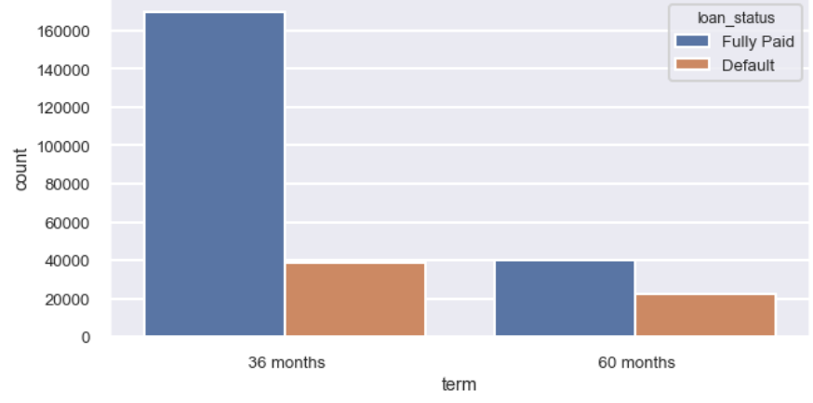
Loan_status vs Term

Slide 5
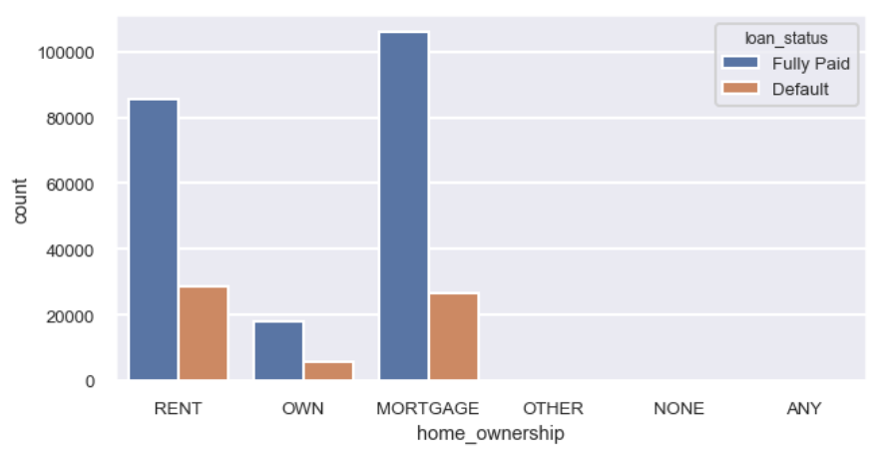
Loan_status vs home_ownership

Slide 6
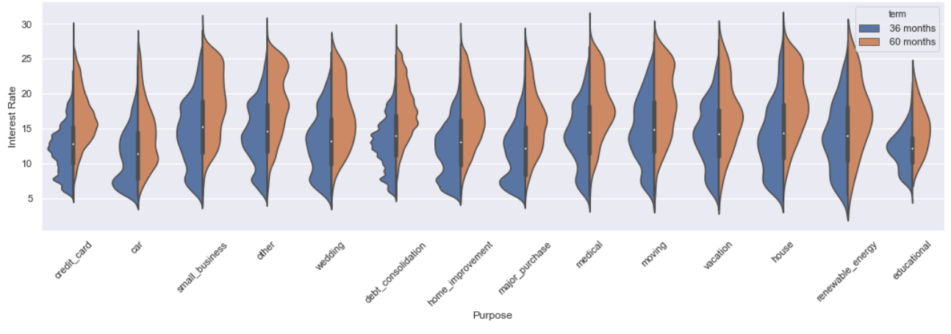
Purpose vs term

Slide 7
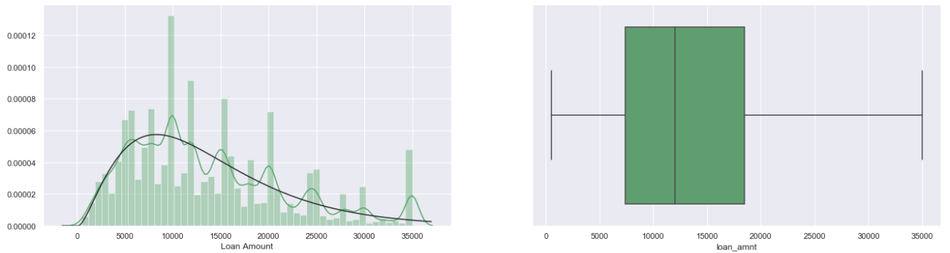
Loan_amount

Slide 8
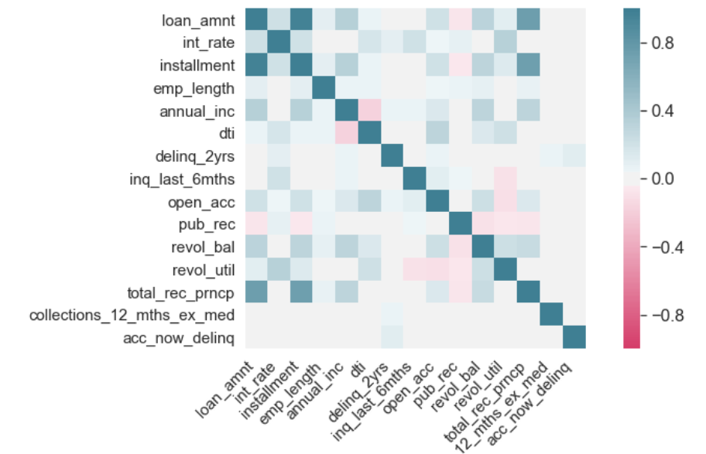
Correlation matrix

Slide 9
References
Emekter, R.; Tu, Y.; Jirasakuldech, B.; Lu, M. Evaluating credit risk and loan performance in online Peer-to-Peer (P2P) lending. Appl. Econ. 2015, 47, 54–70..
Carmichael, D. Modeling Default for Peer-to-Peer Loans. 2014. Available online: http://ssrn.com/abstract= 2529240 (accessed on 31 August 2018).

Slide 10
Thank you!
github account: https://github.com/Ghailemichael/DATA606/branches
email address: gashawh1@umbc.edu

